Slide 1
Elementary Programming
To write Java programs to perform simple calculations
To obtain input from the console using the Scanner class
To use identifiers to name variables, constants, methods, and classes
To use variables to store data
To program with assignment statements and assignment expressions
To use constants to store permanent data
To declare Java primitive data types: byte, short, int, long, float, double, and char
To use Java operators to write numeric expressions
To display current time
To use short hand operators
To cast value of one type to another type
To represent characters using the char type
To represent a string using the String type
To become familiar with Java documentation, programming style, and naming conventions
To input/output using the JOptionPane input dialog boxes

Slide 2

Computing the Area of a Circle
allocate memory for radius
public class ComputeArea {
/** Main method */
public static void main(String[] args) {
double radius;
double area;
// Assign a radius
radius = 20;
// Compute area
area = radius * radius * 3.14159;
// Display results
System.out.println("The area for the circle of radius " +
radius + " is " + area);
}
}
radius
no value
area
no value
radius
20
area
1256.636

Slide 3
Reading Input from the Console
1. Create a Scanner object
Scanner input = new Scanner(System.in);
2. Use the methods next(), nextByte(), nextShort(), nextInt(), nextLong(), nextFloat(), nextDouble(), or nextBoolean() to obtain to a string, byte, short, int, long, float, double, or boolean value. For example,
System.out.print("Enter a double value: ");
Scanner input = new Scanner(System.in);
double d = input.nextDouble();

Slide 4
Identifiers
An identifier is a sequence of characters that consist of letters, digits, underscores (_), and dollar signs ($).
An identifier must start with a letter, an underscore (_), or a dollar sign ($). It cannot start with a digit.
An identifier cannot be a reserved word.
An identifier cannot be true, false, or null.
An identifier can be of any length.

Slide 5
Variables
// Compute the first area
radius = 1.0;
area = radius * radius * 3.14159;
System.out.println("The area is “ + area + " for radius "+radius);
// Compute the second area
radius = 2.0;
area = radius * radius * 3.14159;
System.out.println("The area is “ + area + " for radius "+radius);

Slide 6
Declaring Variables
int x; // Declare x to be an
// integer variable;
double radius; // Declare radius to
// be a double variable;
char a; // Declare a to be a
// character variable;

Slide 7
Assignment Statements
x = 1; // Assign 1 to x;
radius = 1.0; // Assign 1.0 to radius;
a = 'A'; // Assign 'A' to a;

Slide 8
Declaring and Initializing in One Step
int x = 1;
double d = 1.4;

Slide 9
Constants
final datatype CONSTANTNAME = VALUE;
final double PI = 3.14159;
final int SIZE = 3;

Slide 10
Numerical Data Types

Slide 11
Arithmetic/Numeric Operators

Slide 12
Integer Division
+, -, *, /, and %
5 / 2 yields an integer 2.
5.0 / 2 yields a double value 2.5
5 % 2 yields 1 (the remainder of the division)

Slide 13
Remainder Operator
Remainder is very useful in programming. For example, an even number % 2 is always 0 and an odd number % 2 is always 1. So you can use this property to determine whether a number is even or odd. Suppose today is Saturday and you and your friends are going to meet in 10 days. What day is in 10 days? You can find that day is Tuesday using the following expression:

Slide 14
Number Literals
A literal is a constant value that appears directly in the program. For example, 34, 1,000,000, and 5.0 are literals in the following statements:
int i = 34;
long x = 1000000;
double d = 5.0;

Slide 15
Integer Literals
An integer literal can be assigned to an integer variable as long as it can fit into the variable. A compilation error would occur if the literal were too large for the variable to hold. For example, the statement byte b = 1000 would cause a compilation error, because 1000 cannot be stored in a variable of the byte type.
An integer literal is assumed to be of the int type, whose value is between -2³¹ (-2147483648) to 2³¹–1 (2147483647). To denote an integer literal of the long type, append it with the letter L or l. L is preferred because l (lowercase L) can easily be confused with 1 (the digit one).

Slide 16
Floating-Point Literals
Floating-point literals are written with a decimal point. By default, a floating-point literal is treated as a double type value. For example, 5.0 is considered a double value, not a float value. You can make a number a float by appending the letter f or F, and make a number a double by appending the letter d or D. For example, you can use 100.2f or 100.2F for a float number, and 100.2d or 100.2D for a double number.

Slide 17
Scientific Notation
Floating-point literals can also be specified in scientific notation, for example, 1.23456e+2, same as 1.23456e2, is equivalent to 123.456, and 1.23456e-2 is equivalent to 0.0123456. E (or e) represents an exponent and it can be either in lowercase or uppercase.

Slide 18
How to Evaluate an Expression
Though Java has its own way to evaluate an expression behind the scene, the result of a Java expression and its corresponding arithmetic expression are the same. Therefore, you can safely apply the arithmetic rule for evaluating a Java expression.

Slide 19
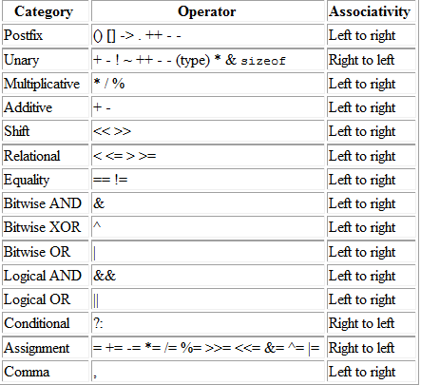
Operator Precedence & Associativity Table

Slide 20
Problem: Converting Temperatures
Write a program that converts a Fahrenheit degree to Celsius using the formula:
Problem: Displaying Current Time
Write a program that displays current time in GMT in the format hour:minute:second such as 1:45:19.

Slide 21
Current Time Calculation
public class ShowCurrentTime {
public static void main(String[] args) {
// Obtain the total milliseconds since midnight, Jan 1, 1970
long totalMilliseconds = System.currentTimeMillis();
long totalSeconds = totalMilliseconds / 1000;
long currentSecond = (int)(totalSeconds % 60); // Obtain the total minutes
long totalMinutes = totalSeconds / 60; // Compute the current minute in the hour
long currentMinute = (int)(totalMinutes % 60); // Obtain the total hours
long totalHours = totalMinutes / 60; // Compute the current hour
long currentHour = (int)(totalHours % 24); // Display results
System.out.println("Current time is " + currentHour + ":" + currentMinute + ":" + currentSecond + " GMT");
}
}

Slide 22
Shortcut Assignment Operators
Operator Example Equivalent
+= i += 8 i = i + 8
-= f -= 8.0 f = f - 8.0
*= i *= 8 i = i * 8
/= i /= 8 i = i / 8
%= i %= 8 i = i % 8

Slide 23
Increment and Decrement Operators
Operator Name Description
++var preincrement The expression (++var) increments var by 1 and evaluates
to the new value in var after the increment.
var++ postincrement The expression (var++) evaluates to the original value
in var and increments var by 1.
--var predecrement The expression (--var) decrements var by 1 and evaluates
to the new value in var after the decrement.
var-- postdecrement The expression (var--) evaluates to the original value
in var and decrements var by 1.

Slide 24
Increment and Decrement Operators, cont.

Slide 25
Increment and Decrement Operators, cont.
Using increment and decrement operators makes expressions short, but it also makes them complex and difficult to read. Avoid using these operators in expressions that modify multiple variables, or the same variable for multiple times such as this: int k = ++i + i.

Slide 26
Assignment Expressions and Assignment Statements
Prior to Java 2, all the expressions can be used as statements. Since Java 2, only the following types of expressions can be statements:
variable op= expression; // Where op is +, -, *, /, or %
++variable;
variable++;
--variable;
variable--;

Slide 27
Numeric Type Conversion
Consider the following statements:
byte i = 100;
long k = i * 3 + 4;
double d = i * 3.1 + k / 2;

Slide 28
Conversion Rules
When performing a binary operation involving two operands of different types, Java automatically converts the operand based on the following rules:
1. If one of the operands is double, the other is converted into double.
2. Otherwise, if one of the operands is float, the other is converted into float.
3. Otherwise, if one of the operands is long, the other is converted into long.
4. Otherwise, both operands are converted into int.

Slide 29
Type Casting
Implicit casting
double d = 3; (type widening)
Explicit casting
int i = (int)3.0; (type narrowing)
int i = (int)3.9; (Fraction part is truncated)
What is wrong? int x = 5 / 2.0;

Slide 30
Character Data Type
Four hexadecimal digits.
char letter = 'A'; (ASCII)
char numChar = '4'; (ASCII)
char letter = '\u0041'; (Unicode)
char numChar = '\u0034'; (Unicode)
NOTE: The increment and decrement operators can also be used on char variables to get the next or preceding Unicode character. For example, the following statements display character b.
char ch = 'a';
System.out.println(++ch);

Slide 31
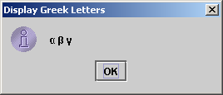
Unicode Format
Java characters use Unicode, a 16-bit encoding scheme established by the Unicode Consortium to support the interchange, processing, and display of written texts in the world’s diverse languages. Unicode takes two bytes, preceded by \u, expressed in four hexadecimal numbers that run from '\u0000' to '\uFFFF'. So, Unicode can represent 65535 + 1 characters.
Unicode \u03b1 \u03b2 \u03b3 for three Greek letters

Slide 32
Escape Sequences for Special Characters
Description Escape Sequence Unicode
Backspace \b \u0008
Tab \t \u0009
Linefeed \n \u000A
Carriage return \r \u000D
Backslash \\ \u005C
Single Quote \' \u0027
Double Quote \" \u0022

Slide 33
Casting between char and Numeric Types
int i = 'a'; // Same as int i = (int)'a';
char c = 97; // Same as char c = (char)97;

Slide 34
Problem: Monetary Units
This program lets the user enter the amount in decimal representing dollars and cents and output a report listing the monetary equivalent in single dollars, quarters, dimes, nickels, and cents. Your program should report maximum number of dollars, then the maximum number of quarters, and so on, in this order.

Slide 35
Trace ComputeChange
Suppose amount is 11.56
int remainingAmount = (int)(amount * 100);
// Find the number of one dollars
int numberOfOneDollars = remainingAmount / 100;
remainingAmount = remainingAmount % 100;
// Find the number of quarters in the remaining amount
int numberOfQuarters = remainingAmount / 25;
remainingAmount = remainingAmount % 25;
// Find the number of dimes in the remaining amount
int numberOfDimes = remainingAmount / 10;
remainingAmount = remainingAmount % 10;
// Find the number of nickels in the remaining amount
int numberOfNickels = remainingAmount / 5;
remainingAmount = remainingAmount % 5;
// Find the number of pennies in the remaining amount
int numberOfPennies = remainingAmount;
remainingAmount
1156
numberOfOneDollars
11
remainingAmount
56
numberOfQuarters
2
remainingAmount
6
numberOfDimes
0
remainingAmount
6
numberOfNickels
1
remainingAmount
1
numberOfPennies
1

Slide 36
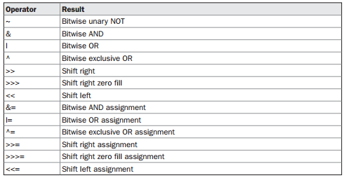
Bitwise Operators

Slide 37
The String Type
The char type only represents one character. To represent a string of characters, use the data type called String. For example,
String message = "Welcome to Java";
String is actually a predefined class in the Java library just like the System class and JOptionPane class. The String type is not a primitive type. It is known as a reference type. Any Java class can be used as a reference type for a variable. Reference data types will be thoroughly discussed in Chapter 7, “Objects and Classes.” For the time being, you just need to know how to declare a String variable, how to assign a string to the variable, and how to concatenate strings.

Slide 38
String Concatenation
// Three strings are concatenated
String message = "Welcome " + "to " + "Java";
// String Chapter is concatenated with number 2
String s = "Chapter" + 2; // s becomes Chapter2
// String Supplement is concatenated with character B
String s1 = "Supplement" + 'B'; // s1 becomes SupplementB

Slide 39
Programming Style and Documentation
Appropriate Comments
Naming Conventions
Proper Indentation and Spacing Lines
Block Styles

Slide 40
Appropriate Comments
Include a summary at the beginning of the program to explain what the program does, its key features, its supporting data structures, and any unique techniques it uses.
Include your name, class section, instructor, date, and a brief description at the beginning of the program.

Slide 41
Naming Conventions
Choose meaningful and descriptive names.
Variables and method names:
Use lowercase. If the name consists of several words, concatenate all in one, use lowercase for the first word, and capitalize the first letter of each subsequent word in the name. For example, the variables radius and area, and the method computeArea.

Slide 42
Naming Conventions, cont.
Class names:
Capitalize the first letter of each word in the name. For example, the class name ComputeArea.
Constants:
Capitalize all letters in constants, and use underscores to connect words. For example, the constant PI and MAX_VALUE

Slide 43
Proper Indentation and Spacing
Indentation
Indent two spaces.
Spacing
Use blank line to separate segments of the code.

Slide 44
JOptionPane Input
This book provides two ways of obtaining input.
Using the Scanner class (console input)
Using JOptionPane input dialogs

Slide 45
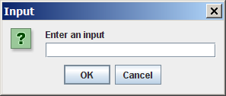
Getting Input from Input Dialog Boxes
String input = JOptionPane.showInputDialog(
"Enter an input");

Slide 46
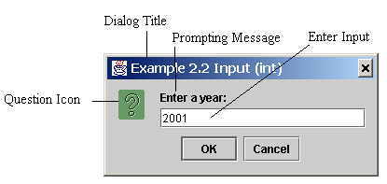
Getting Input from Input Dialog Boxes
String string = JOptionPane.showInputDialog(
null, “Prompting Message”, “Dialog Title”,
JOptionPane.QUESTION_MESSAGE);

Slide 47
Two Ways to Invoke the Method
There are several ways to use the showInputDialog method. For the time being, you only need to know two ways to invoke it.
One is to use a statement as shown in the example:
String string = JOptionPane.showInputDialog(null, msg,
title, JOptionPane.QUESTION_MESSAGE);
where msg is a string for the prompting message, and title is a string for the title of the input dialog box.
The other is to use a statement like this:
JOptionPane.showInputDialog(msg);
where x is a string for the prompting message.

Slide 48
Converting Strings to Integers
The input returned from the input dialog box is a string. If you enter a numeric value such as 123, it returns “123”. To obtain the input as a number, you have to convert a string into a number.
To convert a string into an int value, you can use the static parseInt method in the Integer class as follows:
int intValue = Integer.parseInt(intString);
where intString is a numeric string such as “123”.

Slide 49
Converting Strings to Doubles
To convert a string into a double value, you can use the static parseDouble method in the Double class as follows:
double doubleValue =Double.parseDouble(doubleString);
where doubleString is a numeric string such as “123.45”.

Slide 50
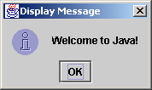
The showMessageDialog Method
JOptionPane.showMessageDialog(null,
"Welcome to Java!",
"Display Message",
JOptionPane.INFORMATION_MESSAGE);

Slide 51
Two Ways to Invoke the Method
There are several ways to use the showMessageDialog method. For the time being, all you need to know are two ways to invoke it.
One is to use a statement as shown in the example:
JOptionPane.showMessageDialog(null, msg,
title, JOptionPane.INFORMATION_MESSAGE);
The other is to use a statement like this:
JOptionPane.showMessageDialog(null, msg);
where x is a string for the text to be displayed.

Slide 52
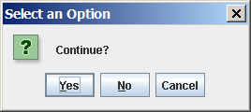
(GUI) Confirmation Dialogs
int option = JOptionPane.showConfirmDialog
(null, "Continue");

